Slide 1
Idea/Approach Details
Technology Bucket : Smart Communication Category: Hardware
Company Name/ Ministry Name: Student Innovation A.I.C.T.E. Smart India Hackathon 2019 Problem Code : A16
Team Leader Name : Shrutika Bansal College Code : 1-3709074021
Underwater Wireless communication can be carried out using radio frequency (RF), acoustics and optical waves. Compared to its bandwidth limited acoustic and RF counterparts, underwater optical wireless communications (UOWCs) can support higher data rates at low latency levels. RF is rendered unusable due to high attenuation and large antennas. In this scenario effective underwater communication has always been a challenge which poses many difficulties especially to scuba divers and underwater exploration. We propose to implement an Underwater Optical Wireless Communication Network using Visible Light Communication (VLC) Technology for the purpose of providing effective communication means for divers along with Sensor Nodes for monitoring the marine environment and the diver for effective real time danger warnings.
Technology Used: Visible Light Communication(VLC), Sensor Networking, IoT;
The setup will be under water consisting of a transceiver pair where both nodes, each node can act as a transmitter as well as a receiver. Transmitter section will consist of a photon source (High powered LED) which will be mounted on first node and receiver will have photon detector mounted on the second node. To cover up the losses caused in the water appropriate modulation and amplification process will be adopted. We will be using edge device technology for better user readability on the surface. Different sensors on the divers suit will be used to acquire critical information like temperature, heartbeat and blood pressure, which will be transmitted using VLC to the surface. At the surface RF communication modules will be used to transfer the information to a centralized server. Resulting in a dual hop VLC-RF end-to-end communication system for acquiring mission critical underwater information.

Slide 2
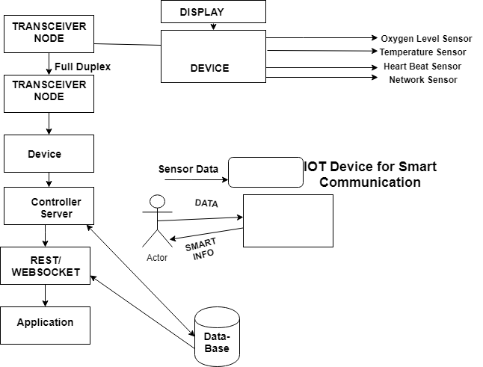
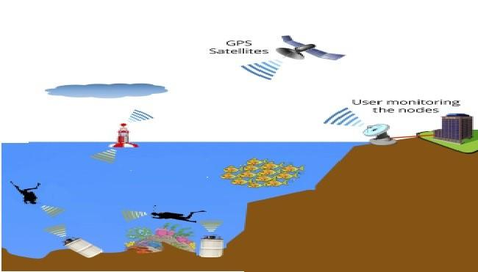
Use cases regarding the project:
The solution to Underwater Wireless Communication and Sensor Network(UWCSN) opens the door to various uses.
The Primary focus of its use will be for the convenience of the Scuba divers since it will provide for a viable communication option and vital details regarding their safety.
UWCSN will provide various governmental agencies/ armed forces underwater surveillance capabilities. For example
It will be of immense use in Oil Exploration and Oil Rig maintenance and data collection in real time.
Merchant Navy will be immensely benefited by UWCSN.
Rescue Operation in Mines and Caves will become easier and drastically reduce the time to operation of the equipment since they are lightweight, portable, low energy devices.
For diagrams click here.

Slide 3
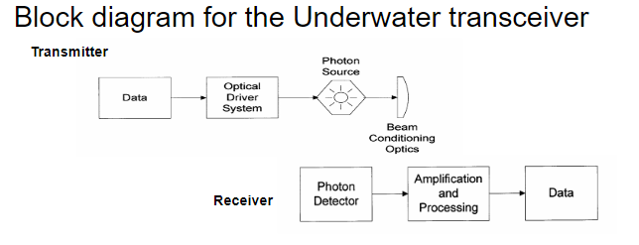
To implement this project, we would need permission from the Telecom Regulatory Authority of India (TRAI).

